Slide 1



Slide 2
Project
Unique, one-time operations designed to accomplish a specific set of objectives in a limited time frame
Characteristics of a project
Unique
Temporary
Specific due date
Specific deliverable
Multidisciplinary
Resource requirements and trade offs

Slide 3
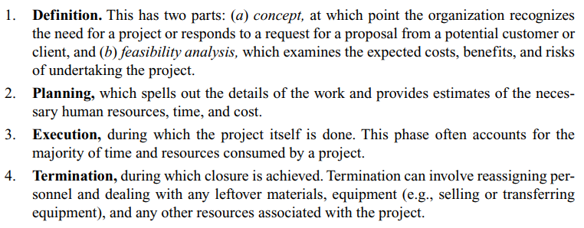
Project Life Cycle
Consists of four phases:

Slide 4
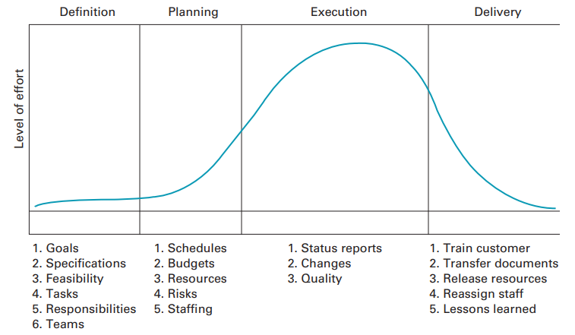
Fig: Project life cycle

Slide 5
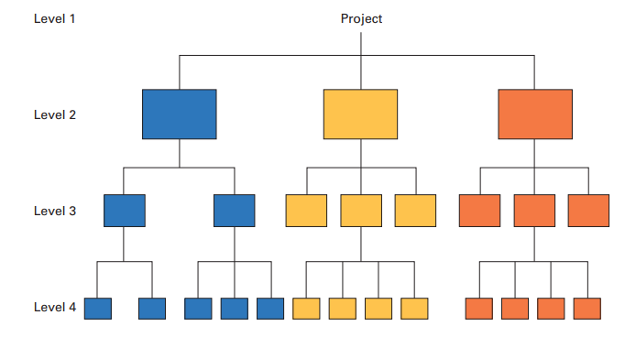
Work Breakdown Structures
A hierarchical listing of what must be done during a project.
Fig: Work breakdown structure

Slide 6
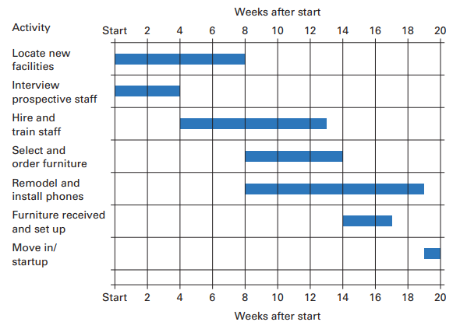
Gantt Chart
The Gantt chart is a popular visual tool for planning and scheduling simple projects. It enables a manager to initially schedule project activities and then to monitor progress over time by comparing planned progress to actual progress.
Fig: Gantt chart

Slide 7
PERT & CPM
PERT Program evaluation and review technique, for planning and coordinating large projects.
CPM Critical path method, for planning and coordinating large projects.
A graphical display of project activities.
An estimate of how long the project will take.
An indication of which activities are the most critical to timely project completion.
An indication of how long any activity can be delayed without delaying the project.

Slide 8
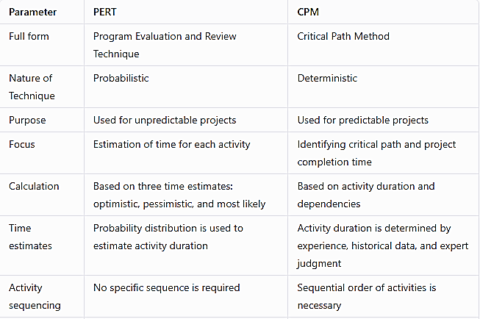
Comparison between PERT & CPM

Slide 9
The Network Diagram
Network (precedence) diagram Diagram of project activities that shows sequential relationships by use of arrows and nodes.
Activity-on-arrow (AOA) Network diagram convention in which arrows designate activities.
Activity-on-node (AON) Network diagram convention in which nodes designate activities.
Activities Project steps that consume resources and/or time.
Events The starting and finishing of activities, designated by nodes in the AOA convention.
Path A sequence of activities that leads from the starting node to the finishing node.
Critical path The longest path; determines expected project duration.
Slack Allowable slippage for a path; the difference between the length of a path and the length of the critical path.

Slide 10
The Network Diagram
Parameter | Activity on Arrow (AOA) | Activity on Node (AON)
Full form | Also known as Arrow Diagramming Method (ADM) | Also known as Precedence Diagramming Method (PDM)
Representation | Arrows represent activities, and nodes represent events or points in time | Nodes represent activities, and arrows represent the sequence or dependencies between them
Dependency notation | Uses finish-to-start notation for dependencies (arrow from predecessor's finish to successor's start) | Uses start-to-finish, start-to-start, and finish-to-finish notation for dependencies
Use of dummy activities | Uses dummy arrows to represent dependencies that don't have a physical presence in the project | Doesn't use dummy activities
Ease of understanding | Can be confusing due to the use of dummy arrows and complex diagrams | Generally easier to understand because the nodes represent activities and the arrows represent dependencies
Network structure | Can lead to complex network structures | Network structures tend to be simpler and more compact
Critical path analysis | Critical path is determined by the longest sequence of activities and arrows that lead to project completion | Critical path is determined by the longest sequence of activities and dependencies
Application | Suitable for complex projects with a large number of activities | Suitable for projects with well-defined tasks and a smaller number of activities
Limitations | Can be difficult to update and maintain, can lead to diagram clutter | Limited use of dependency types, doesn't handle concurrency well

Slide 11
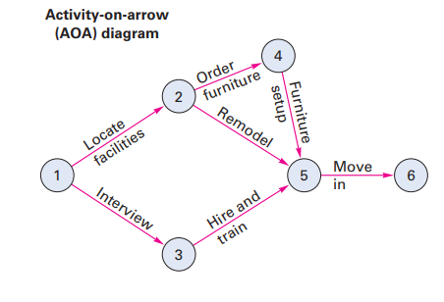
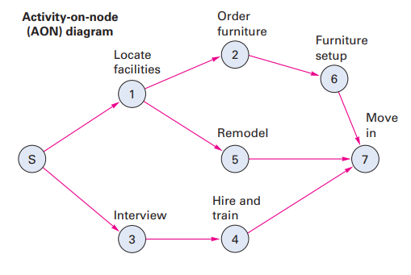
The Network Diagram

Slide 12
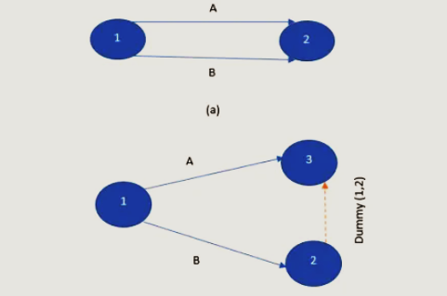
Dummy activity
A dummy activity can be used to prevent two arrows with a common beginning and end points

Slide 13
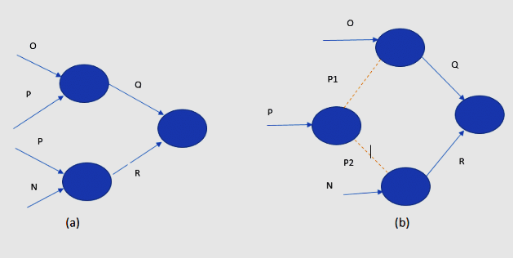
It is difficult to represent an activity having two sets of operation running parallel to each other in a network. The use of a dummy activity helps to give a logical representation without difficulty in interpretation.

Slide 14
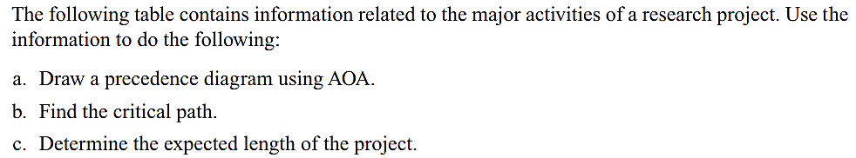
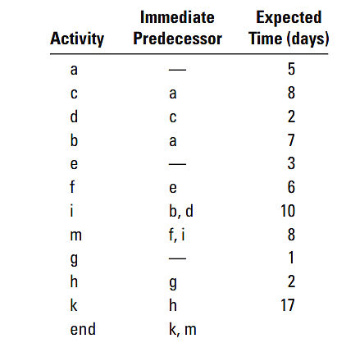

Slide 15

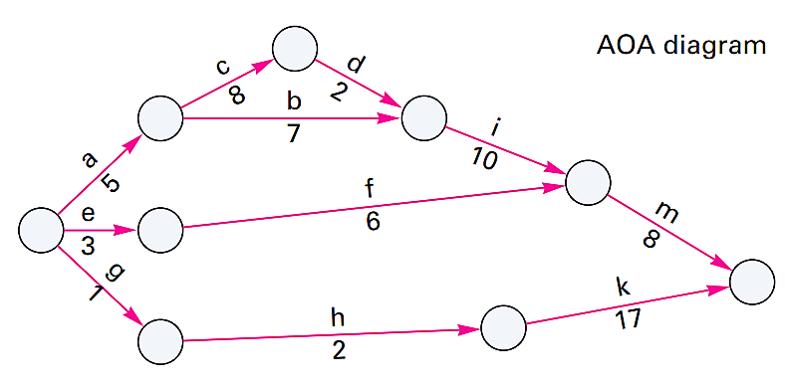
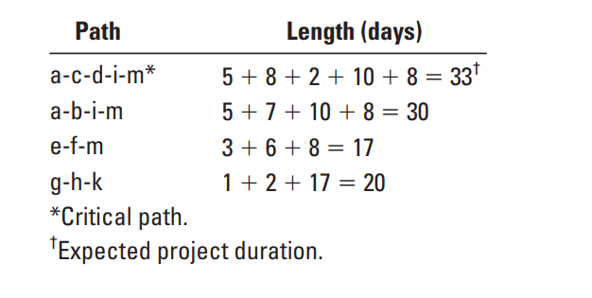

Slide 16
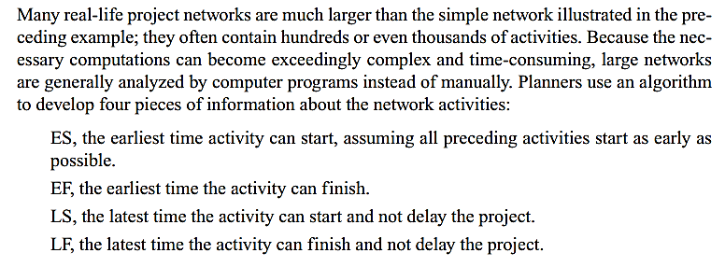
A computing algorithm

Slide 17
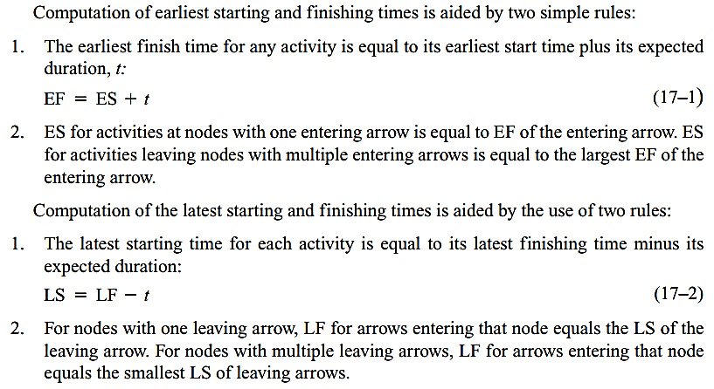
A computing algorithm

Slide 18
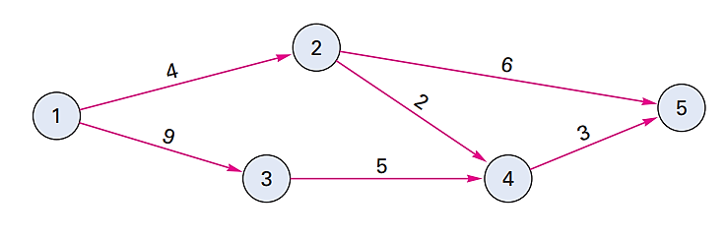
Using the computing algorithm, determine the slack times for the following AOA diagram. Identify the activities that are on the critical path.

Slide 19
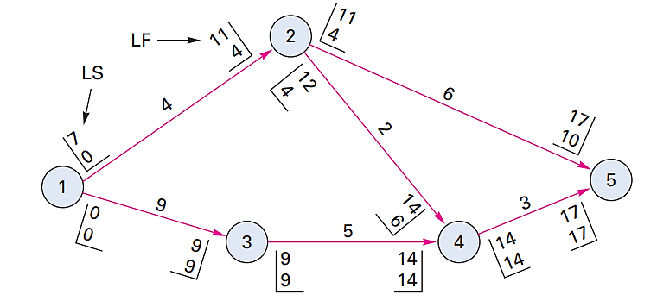

Slide 20
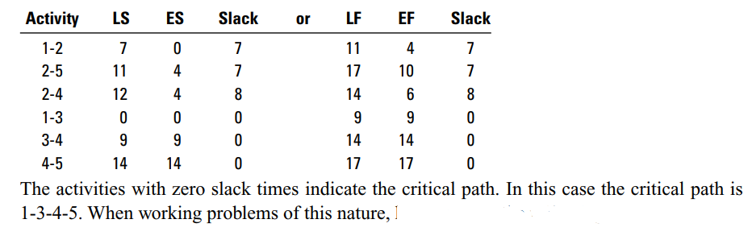

Slide 21
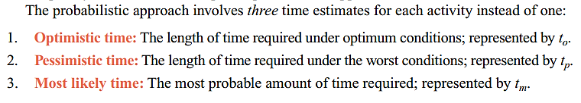
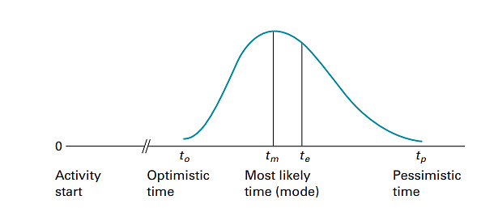
Probabilistic time estimates
Fig: A beta distribution is used to describe probabilistic time estimates

Slide 22
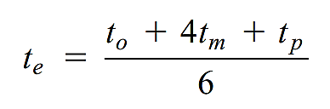
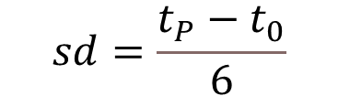


The expected time of an activity, t_{e}, is a weighted average of the three time estimates:
The standard deviation of each activity’s time is estimated as one-sixth of the difference
between the pessimistic and optimistic time estimates
Variance

Slide 23
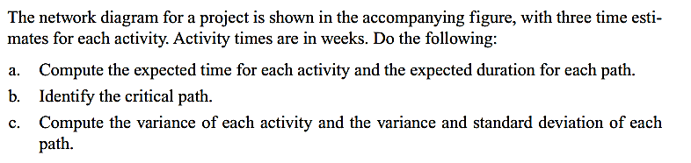
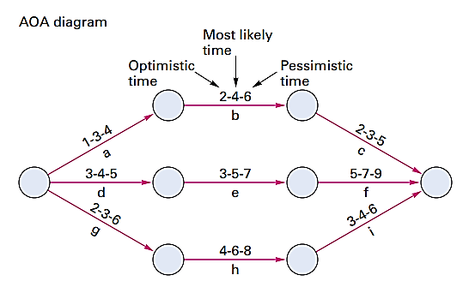

Slide 24
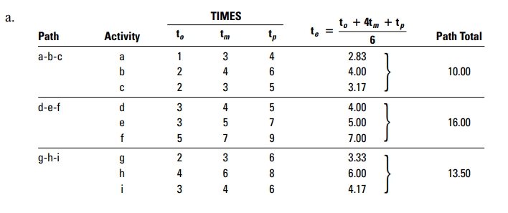

Slide 25
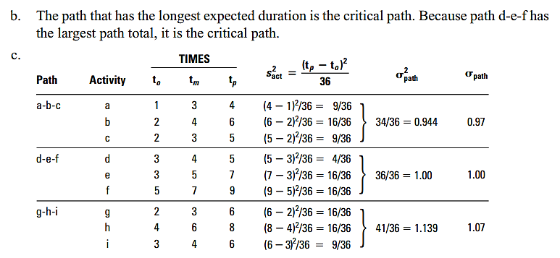

Slide 26
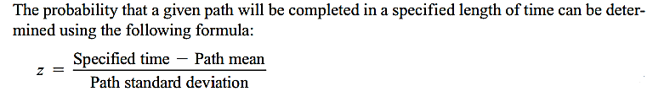
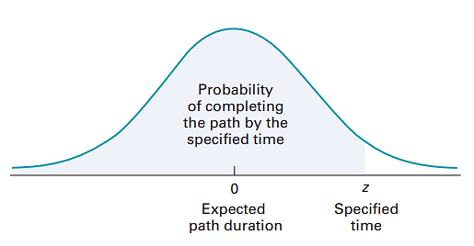
Determining path probabilities

Slide 27
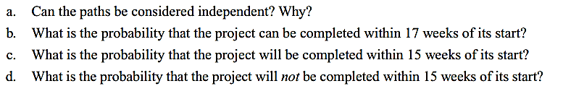
Using the information from previous problem , answer the following questions:

Slide 28
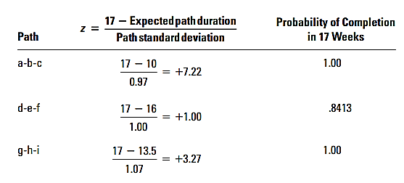
b.

Slide 29
